Slide 1

Chapter 11
Unique Marketing Issues
Bruce R. Barringer
R. Duane Ireland

Slide 2

Chapter Objectives
1 of 2
Explain the purpose of market segmentation.
Describe the importance of selecting a target market.
Explain why its important for a start-up to establish a unique position in its target market.
Describe the importance of the ability to position a company’s products on benefits rather than features.
Illustrate the two major ways in which a company builds a brand.

Slide 3

Chapter Objectives
2 of 2
Identify the four components of the marketing mix.
Explain the difference between a core product and an actual product.
Contrast cost-based pricing and value-based pricing.
Explain the differences between advertising and public relations.
Weigh the advantages and disadvantages of selling direct versus selling through intermediaries.

Slide 4

Selecting a Market and Establishing a Position
Important Questions That All Startups Must Ask
In order to succeed, a new firm must address this important issue: Who are our customers are how will we appeal to them?
A well-managed start-up approaches this query by
following a three-step process:
Segmenting the market.
Selecting a target market.
Establishing a unique position in the target market

Slide 5

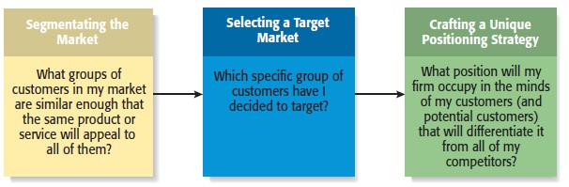
The Process of Selecting a Target Market and Positioning Strategy

Slide 6

Market Segmentation
Involves studying a firm’s industry and determining the different target markets in that industry.
Segmenting the Market

Slide 7
Market Segmentation
Markets can be segmented in a number of different ways, including
Geography
Demographic variables
Psychographic variables
Behavioral variables
Product type
Price point
Customers served
Segmenting the Market

Slide 8

Example: Segmenting the Computer Industry by Product Type
Handheld Computers
Netbooks
(new category)
PCs
Minicomputers
Mainframes

Slide 9

Market Segmentation
To test whether you have segmented your market successfully, the requirements for successful market segmentation are as follows:
Homogeneity of needs and wants appears within the segment.
Heterogeneity of needs and wants exists between the segments.
Differences within the segment should be small compared to differences across segments.
The segment should be distinct enough so that its members can be easily identified.
It should be possible to determine the size of the segment.
The segment should be large enough to be profitable.

Slide 10

Selecting a Target Market
Once a firm has segmented the market, a target market must be chosen.
The market must be sufficiently attractive and the firm must have the capability to serve it.
A niche market is a place within a market segment that represents a narrow group of customers with similar interests.
Target Market

Slide 11
Selecting a Target Market
By focusing on a clearly defined market, a firm can become an expert in that market and then be able to provide its customers with high levels of value and service.
A firm’s choice of target markets must also be in sync with its business model and the backgrounds and skills of its founders and other employees.
A firm must also continually monitor the attractiveness of its target market. Societal preferences change, sometimes causes a target market to lose its attractiveness and the product or service it has to offer customers.

Slide 12

Establishing a Unique Position
The firm’s next step is to establish a “position” within the market that differentiates it from its competitors.
Position is concerned with how the firm is situated relative to competitors.
A “position” is the part of a market
that the firm is claiming as its own.
Positioning

Slide 13
Establishing a Unique Position
A firm establishing a unique position in its customers’ minds by drawing attention to two or three of the product’s attributes.
A firm’s position is defined by its products or services.
Determining which position to occupy and compete in is a strategic call on the part of a company based on its mission, its overall approach to the marketplace, and its competitive landscape.
Once a company has identified its position and primary points of differentiation, a helpful technique is to develop a product attribute map, which illustrates a firm’s positioning strategy relative to its major rivals.

Slide 14

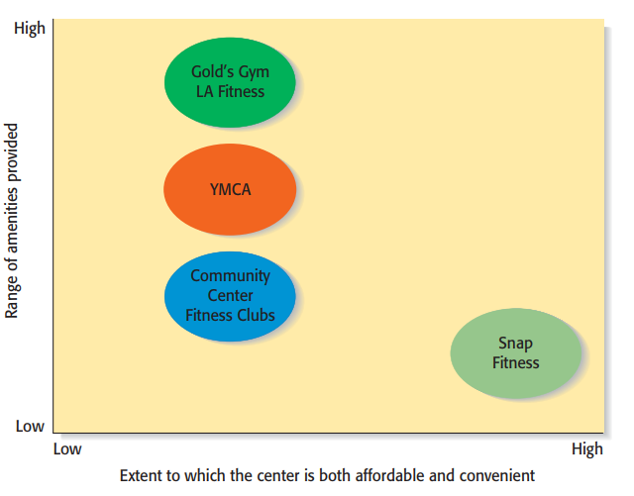
Product Attribute Map for Snap-Fitness

Slide 15
Establishing a Unique Position
Firms often develop a “tagline” to reinforce the position they have staked out in market.
A tagline is catchy phrase that’s used consistently in a company’s literature, advertisements, stationery, and even invoices and thus becomes associated with that company to reinforce the position they have staked out in their market.
An example is Nike’s familiar tagline, “Just do it.”
The beauty of this simple three-word expression is that it applies equally to a 21-year-old athlete and a 65-year-old mall walker.

Slide 16
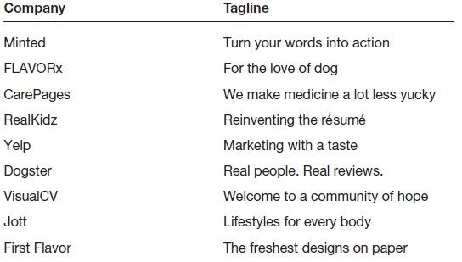
Taglines—Developed to Reinforce a Firm’s Positioning Strategy
Match the Company to its Tagline

Slide 17

Selling Benefits Rather Than Features
1 of 2
Many entrepreneurs make the mistake of positioning their company’s products or services on features rather than benefits.
A positioning or marketing strategy that focuses on the features of a product, such as its technical merits, is usually much less effective than a campaign focusing on what the merits of the product can do.

Slide 18

Selling Benefits Rather Than Features
2 of 2
Two different approaches to promoting a cell phone
Approach | Illustration
Selling Features | “Our cell phones are equipped with sufficient memory to store 1,000 phone numbers.”
Selling Benefits | “Our cell phones let you store up to 1,000 phone numbers, providing you access to the phone numbers of your family, friends, and business contacts instantly.
Conclusion | The first statement tells a prospect how many phone numbers the cell phone will hold but doesn’t say why that’s important. The second statement tells a prospect how buying the product will enhance his or her life or business.

Slide 19

BRANDING
A brand is the set of attributes—positive or negative—that people associate with a company.
These attributes can be positive, such as trustworthy, dependable, or easy to deal with. Or they can be negative, such as cheap, unreliable, or difficult to deal with.
The customer loyalty a company creates through its brand is one of its most valuable assets.
Some companies monitor the integrity of their brands through “Brand Management” which is a program used to protect the image and value of an organization’s brand in consumers’ minds.
Start-ups must build a brand from scratch; this process begins with selecting the company’s name. One of the keys to effective branding is to create a strong personality for a firm, designed to appeal to the chosen target market.

Slide 20

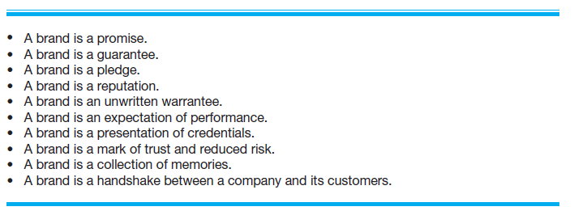
BRANDING
Different Ways of Thinking About the Meaning of a Brand

Slide 21

BRANDING
So how does a new firm establish a brand?
On a philosophical level, a firm must have meaning in its customers’ lives. It must create value—something for which customers are willing to pay.
On a more practical level, brands are built through a number of techniques, including advertising, public relations, sponsorships, support of social causes, social media and good performance.
A firm’s name, logo, Web site design, Facebook page and even its letterhead are part of its brand.
Experts warn against placing an overreliance on advertising to build brand. A more affordable approach is to rely on word of mouth, media, and ingenuity to create a positive buzz about a company.
Creating buzz means creating awareness and a sense of anticipation about a company and its offerings. This process can start during feasibility analysis, when a company shows its concept statement or prototype to prospective buyers or industry experts.

Slide 22

BRANDING
Ultimately, a strong brand can be a very powerful asset for a firm. As a result, a brand allows a company to charge a price for its products that is consistent with its image.
Brand equity is the term that denotes the set of assets and liabilities that are linked to a brand and enable it to raise a firm’s valuation.
It is important for firms to understand brand equity and how to use it to create value. Although the assets and liabilities that make up a firm’s brand equity vary from context to context, they usually are grouped into the five categories:
Brand loyalty
Name recognition
Perceived quality (of a firm’s products and services)
Brand associations in addition to quality (e.g., good service)
Other proprietary assets, such as patents, trademarks, and high-quality partnerships

Slide 23

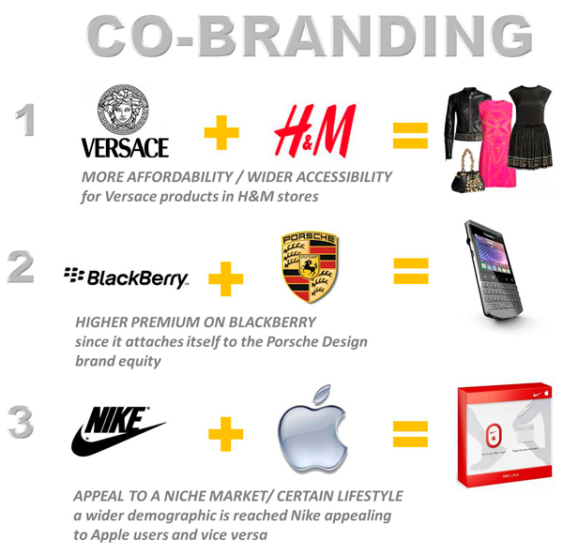
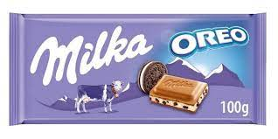
BRANDING
Cobranding
A technique that companies use to strengthen their brands
is to enter into a cobranding arrangements with other firms.
Cobranding refers to a relationship between two or more firms where the firm’s brands promote each another.

Slide 24
The Four Ps of Marketing for New Ventures
Next step: Marketing Mix
A firm’s marketing mix is the set of controllable, tactical marketing tools that it uses to produce the response it wants in the target market.
Most marketers organize their marketing mix into four categories commonly referred to as the 4Ps.
The way a firm sells and distributes its product dramatically affects a company’s marketing program. This effect means that the first decision a firm has to make is its overall approach to selling its product or service.
A firm’s marketing program should be consistent with its business model and its overall business plan.

Slide 25

The Four Ps of Marketing for New Ventures
Product
Price
Marketing Mix
Promotion
Place (or distribution)

Slide 26

Product
A product is the good or service a firm offers to its target market.
A service is an activity or benefit that is intangible and does not take on a physical form.
The most important attribute of a product is that it adds value in the minds of its target customers.
All firms face the challenge that they are unknown and that it takes a leap of faith for the first customers to buy their products.
Some startups meet this challenge by using reference accounts: an early user of a firm’s product who is willing to give a testimonial regarding his or her experience with the product.
To obtain reference accounts, new firms must often offer their product to an initial group of customers for free or at a reduced price in exchange for their willingness to try the product and for their feedback.

Slide 27

Core Product vs. Actual Product
Core Product
Actual Product
The product itself, such as an antivirus software program.
The product plus all the attributes that come with it such as quality level, features, design, packaging, and warranty.

Slide 28

Price
Price is the amount of money consumers pay to buy a product.
It is the only element in the marketing mix that produces revenue; all other elements represent costs.
The price a company charges for its products sends an important message to its target market.
Most entrepreneurs use one of two methods to set the price
for their products: cost-based pricing or value-based pricing.

Slide 29
Cost-Based Pricing
The list price is determined by adding a markup percentage to a product’s cost.
The markup percentage may be standard for the industry or may be arbitrarily determined by the entrepreneur.
Advantage: straightforward, relatively easy to justify the price.
Disadvantage: not always easy to estimate what the costs of a product will be.

Slide 30
Value-Based Pricing
The list price is determined by estimating what consumers are willing to pay for a product.
What a customer is willing to pay is determined by the perceived value of the product and by the number of choices available in the marketplace.
A firm influences its customer’s perception of the value through positioning, branding, and the other elements of the marketing mix.
Most consumers make a price-quality attribution when looking at the price of a product means that consumers naturally assume that the higher-priced product is also the better-quality product.

Slide 31

Price a company is able to charge is largely a function of
the objective quality of a product or service
the perception of value that you create in the minds of your customers relative to competing products in the marketplace.
These are issues a firm should consider when developing its positioning and branding strategies.

Slide 32
Promotion
Promotion refers to the activities the firm takes to communicate the merits of its product to its target market.
There are several common activities that entrepreneurs use to promote their products and services.
Advertising
Advertising is making people aware of a product or service in hopes of persuading them to buy it.

Slide 33

Pluses and Minuses of Advertising
Pluses
Raise customer awareness of a product.
Explain a product’s comparative features and benefits.
Create associations between a product and a certain lifestyle.
Minuses
Low credibility.
The possibility that a high percentage of people who see the ad will not be interested.
Message clutter.
Costliness.
The perception that advertising is intrusive.

Slide 34
Along with engaging in hybrid promotional campaigns, many start-ups advertise in trade journals or utilize highly focused pay-per-click advertising provided by Google, Bing, or another online firm to economize the advertising dollars.
Pay-per-click advertising represents a major innovation in advertising and has been embraced by firms of all sizes. Google has two pay-per-click programs—AdWords and AdSense.
Another medium for advertising is advertising through social media sites, like Facebook.

Slide 35
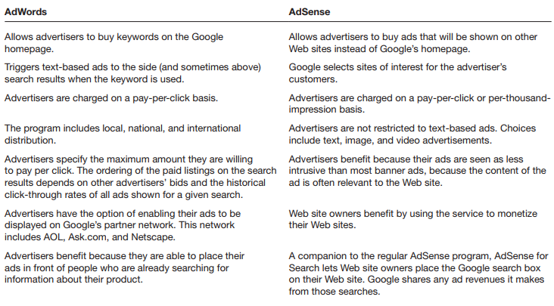
Description of Google AdWords and AdSense Programs for Advertisers and Website Owners

Slide 36

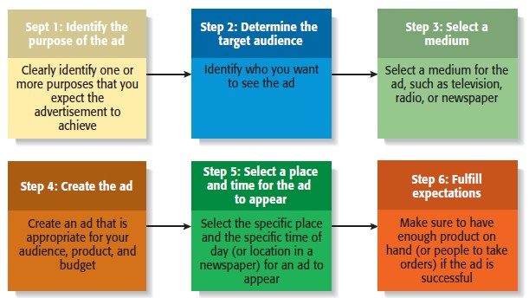
Steps Involved in Putting Together an
Advertisement

Slide 37

Public Relations
Public Relations
One of the most cost-effective ways to increase the awareness of the products a company sells is through public relations.
Public relations refer to efforts to establish and maintain a
company’s image with the public.
The major difference between public relations and advertising is that public relations is not paid for—directly.

Slide 38

Public Relations Techniques
Press release
Media coverage
Articles in industry press and periodicals
Blogging
Monthly newsletter
Social Media coverage
Civic, social, and community involvement

Slide 39
Public Relations
There are many ways in which a start-up can enhance its chances of getting noticed by the press, a blogger, or someone who is influential in social media.
One technique is to prepare a press kit, which is a folder that contains background information about the company and includes a list of its most recent accomplishments.
Another technique is to be present at industry trade shows and other events. A trade show is an event at which the goods or services in a specific industry are exhibited and demonstrated.
Social Media: Social media consists primarily of blogging and establishing a presence and connecting with customers and others through social networking sites like Facebook or Twitter.

Slide 40
Other Promotion-Related Activities
There are many other activities that help a firm promote and sell its products.
Some firms, for example, give away free samples of their products.
A similar technique is to offer free trials such as a three-month subscription to a magazine etc
Viral marketing, which facilitates and encourages people to pass along a marketing message about a particular product.
Guerrilla marketing is a low-budget approach to marketing that relies on ingenuity, cleverness, and surprise rather than traditional techniques. The point is to create awareness of a firm and its products, often in unconventional and memorable ways.

Slide 41

Place (or Distribution)
Encompasses all the activities that move a firm’s product from its place of origin to the consumer.
A distribution channel is the route a product takes from the place it is made to the customer who is the end user.
The first choice a firm has to make regarding distribution is whether to sell its products directly to consumers or through intermediaries (such as wholesalers and retailers).
Within most industries, both choices are available, so the decision typically depends on how a firm believes its target market wants to buy its product.

Slide 42

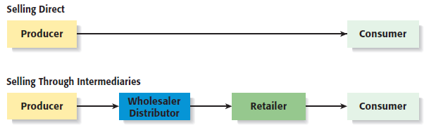
Selling Direct Versus Selling Through a Intermediary
2 of 2

Slide 43

Selling Direct Vs. Selling Through an Intermediary
1 of 2
Approach to Distribution | Description
Selling Direct | Many firms sell direct to customers, maintaining control of the distribution and sales process instead of relying on third parties is a major advantage. Disadvantage is that a firm has more of its capital tied up in fixed assets
Selling Through Intermediaries | Firms selling through intermediaries pass off their products to wholesalers who place them in retail outlets to be sold. Advantage is firm does not need to own as much of the distribution channel. Disadvantage is a firm loses a certain amount of control of its product.

Slide 44
Sales Process and related issues
A firm’s sales process (or sales funnel) depicts the steps it goes through to identify prospects and close sales.
It enables a firm to fine-tune its approach to sales and build uniformity into the process.
It helps a firm qualify leads, so the firm can spend its time and money pursuing the most likely buyers of its products or services.
Some new ventures include this material in their business plan, to provide the reader confidence that they’ve thought through how they’ll close sales.
Having a well-thought-out sales process, with accompanying action steps and appropriate employee training, can dramatically improve a company’s sales performance.

Slide 45
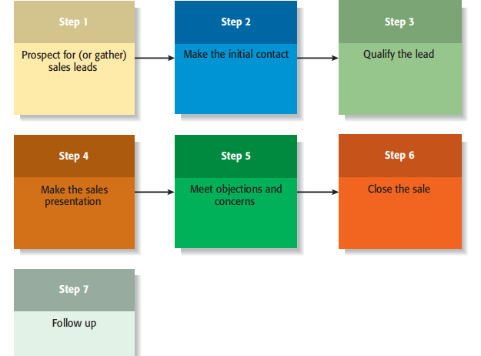
Sales Process

